Slide 1
ADAS storage requirements and marketing materials

Slide 2
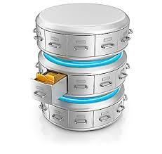
Storage requirements
Phase | Data collection and pre-processing | AI Training | Validation, simulation, SIL, HIL | Backup and archiving
Core requirements | Support expansion to hundreds of PBs | Support large number of small files, high throughput, and ultra-low latency | Support high throughput | High capacity, low cost, long term
Process, Sample, Reduce
Sensor & Algorithm
Control Logic Validation
AI Training
Dvlp+Test(Open loop)
Software in loop
Test Vehicle
Ingest/Store
Generate code
Integrate
Build
Sensor data & CAN Bus data
Performance Simulation
Hardware in loop
Render/convert
Tag
Replay
Simulate
ML data set ->ML->Model
Model deployment
SMB/NFS/S3
NFS
NFS/S3/HDFS
NFS
SMB/NFS/S3/HDFS multi-protocol interoperability
Can reach
100PB level
100TB level
Can reach
100PB level
100TB level
20-100GB/s Throughput
Hundreds of microseconds latency
20GB/s+ Throughput
5GB/s Throughput
High density
Low cost
Storage as a service
Tiering
Global Access
Multi-Tenancy
WORM
Life-cycle based data management and data flow

Slide 3

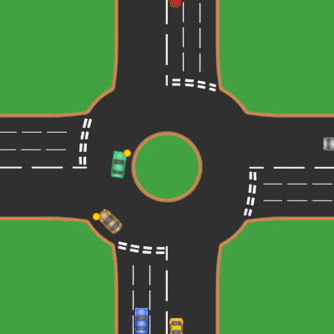
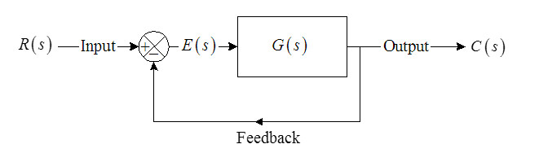




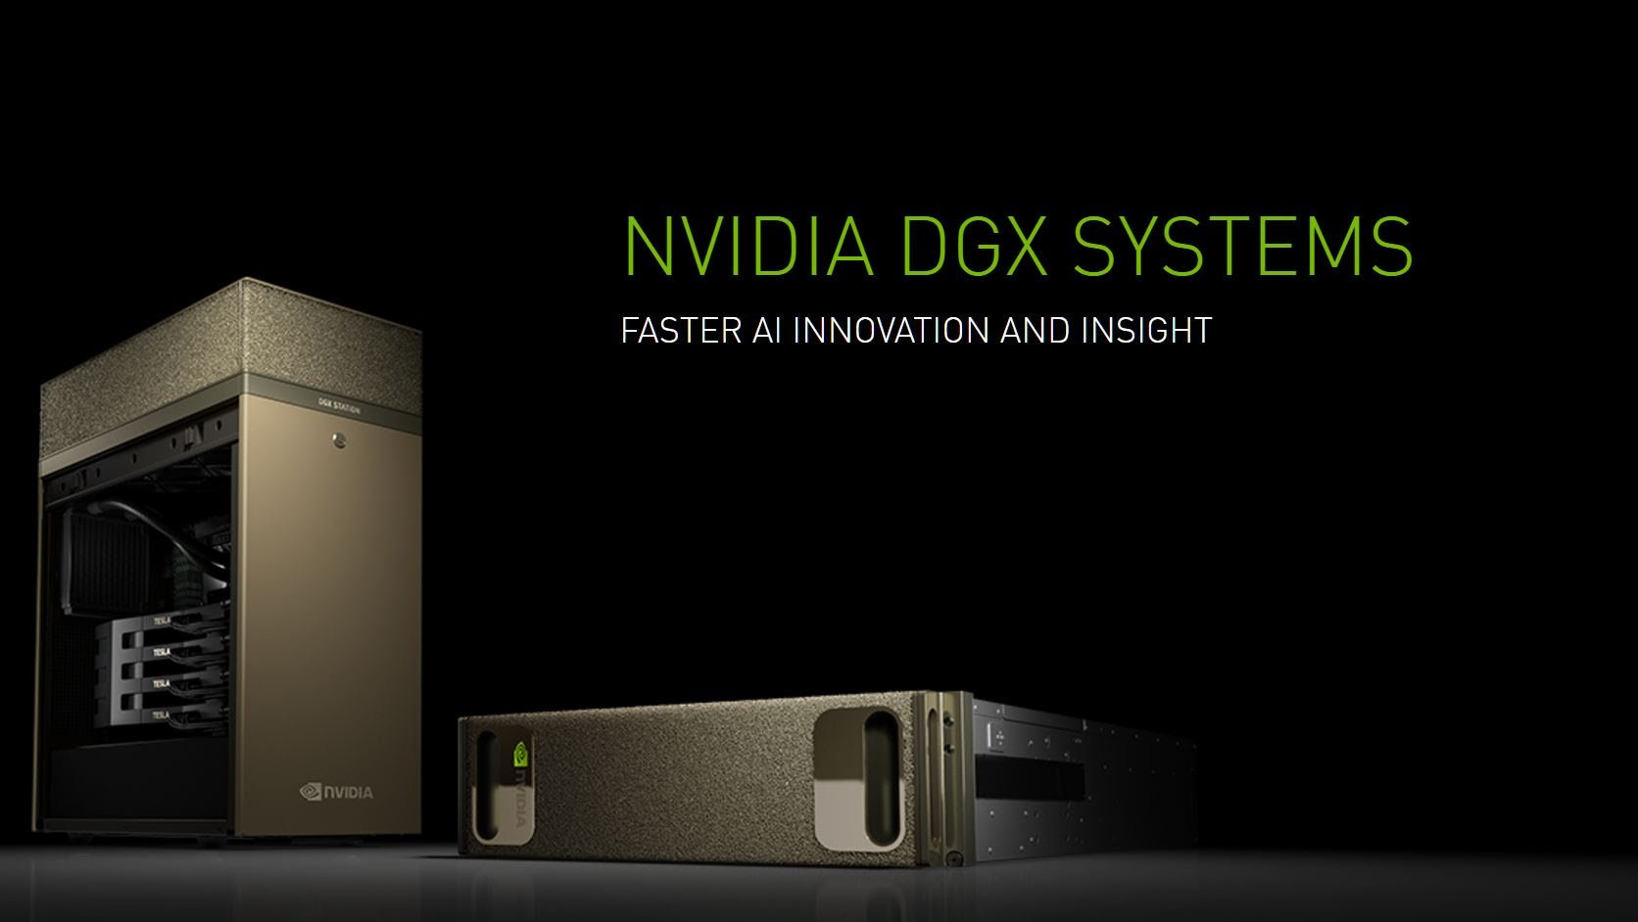
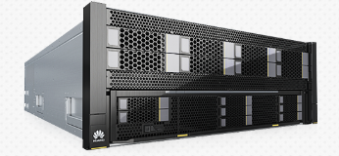

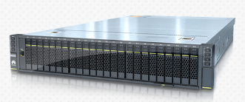
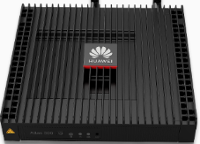


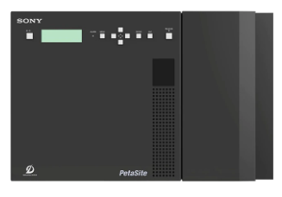

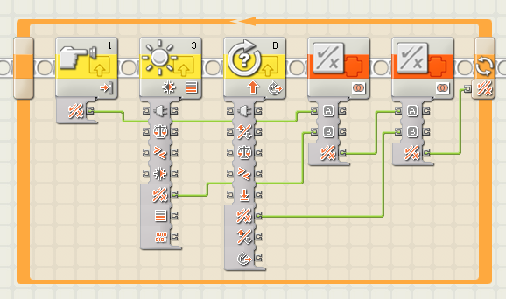
ADAS on-prem Storage Solution Recommendation
Road test Data collection
Data Ingestion and preparation
Simulation, modeling and training
Training set
generator
Simulation
Control Model development
AI training
Testing staff on the road
Cleaning
Tagging
Training data
Training staff
Huawei Servers Compute and VDI
GPU accelerated computation
Storage box
Huawei FusionServer VDI
Storage Link
Capacity, throughput SLA
Throughput, latency SLA
OceanStor NAS
OceanStor NAS High performance tier
Backup and archive
Storage Link
Capacity SLA
Software in loop
Hardware in loop
Cloud
Lab testing staff
OceanStor NAS
SONY optical disk archive
Backup and Archiving
Verification in lab

Slide 4
Process, sample,
reduce
Control logic
validation
Render/convert
Tag
Development
AI Training
Simulation
Capacity, throughput SLA
Performance
simulation
Throughput, latency SLA
Ingest/Store
OceanStor NAS high performance tier
OceanStor NAS
Software in loop
testing
Storage as a service
Support hundreds of PBs
File/Block/Object multi-protocol
High-performance storage
Performance tier supports 20—100GB/s throughput,
and maximizes GPU performance
Hardware in loop
testing

